Slide 1
NPC Future Transportation Fuels Study Overview of Light Duty Vehicle Analytical Models and Tools
April 25, 2012

Slide 2
Modeling Methodology Overview
INPUTS
MODELS
OUTPUTS
Fuels & Infrastructure Model
Vehicle
Attribute
Model
Inputs from Study Step 1
Vehicle technology prices
Propulsion system prices
Fueling infrastructure
Fuel pathway prices
Biofuel supply curves
Other inputs
AEO2010 oil price scenarios
GHG factors for fuels
Integrating Parameters
Fuel consumed
GHG emissions
Fleet share of vehicles by type
Vehicle cost of fleet (cents/mile)
Fuel cost (cents/mile)
Vehicle miles traveled
Vehicle attributes &
fuel characteristics
Vehicle
Choice
Model
Mkt. share by year
for new sales
VISION Tool

Slide 3
Modeling Methodology Overview
Model files and how they link
❶ Matrix worksheet in matrixCollection.xls This file lists the cases to be run. The macro drives the other files by looping through cases and writing case parameters.
❷ Inputs.xls Vehicle Attribute Model Includes fuel prices and vehicle technology parameters from the chapter work. Provides vehicle and fuel attributes to Vehicle Choice Model. Stores biofuel volumes with corresponding GREET coefficients and fuel dispensing and charging costs.
case parameters
oil price case identifier time horizon case identifier
vehicle attributes fuel attributes
case numbers
❹ VISIONbase.xls VISIONhigh.xls VISIONlow.xls VISION Tool for three oil cases Fleet stock is tracked and energy / fuel use computed
biofuel and fuel dispensing and charging infrastructure attributes
❸ VCM.xls Vehicle Choice Model Market shares are computed for use by VISION. Vehicle and fuel attributes are passed through to VISION.
market shares vehicle attributes fuel attributes
case results - outputs regarding new vehicles
case results - outputs regarding vehicle fleet
❺ CaseResults.xls Captures key outputs from VCM and VISION. Calculates various ratios and aggregates as additional outputs
case results
Macro read / write
❶ Collection and CollectMktSh worksheets in matrixCollection.xls Repository for results. Case parameters and results for key years are written to these worksheets.
Link
DRAFT – DO NOT CITE OR QUOTE For NPC Study Discussion Only
3

Slide 4
Case Structure and Terminology
PEV
Liq ICE
CNGV
PHEV
BEV
FCEV
Conventional
CNGV
PHEV10
BEV100
FCEV
HEV
PHEV40
10 Portfolios
Diesel
8 Toggles
All In
Efficiency Tech Prices upper / lower
Liq ICE
3 System Tech Prices upper / lower
4 Tech Prices high / low
4 Tech Prices high / low
Liq ICE + CNGV
Hydrogen Prices high / low
Liq ICE + PEV
Liq ICE + PHEV
Oil Prices high / ref / low
X
Liq ICE + BEV
Electric Charging home / ubiquitous
Liq ICE + FCEV
Biofuel Supply high / low / no adv
All In - CNGV
X
All In - PEV
3 yr / 17 yr Time Horizons
All In - FCEV
Conv / HEV / Diesel / PHEVs (green outline) consume biofuel
Run = 2,988 total cases

Slide 5
Dashboard Tools

Slide 6
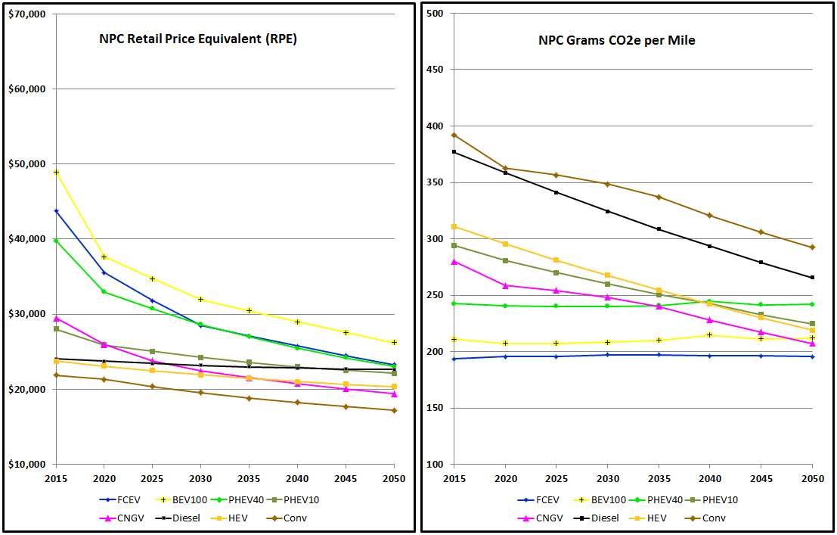
❶ Swimlane Charts for Case-by-Case Comparison of Vehicle Attributes Example: Tech Prices High; Fuel Low; 47,500 miles (3yr); Small Car; HC
Note: this example is 1 case of 384 cases that are generated in the Vehicle Attribute Model
Note: this example is 1 case of 384 cases that are generated in the Vehicle Attribute Model

Slide 7
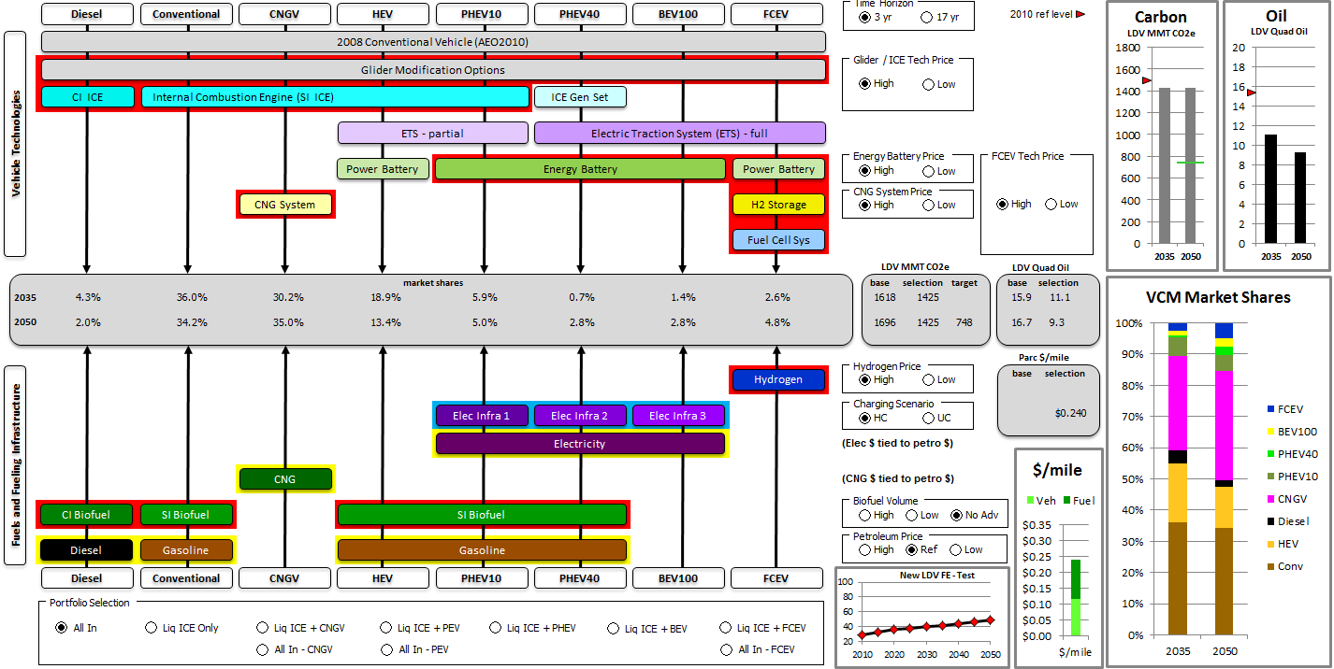
❷ Case Dashboard for Vehicle Choice Model and VISION Outputs Example: All In; Tech Prices High; Petro Ref; Hydrogen High; Home Charging; 47,500 miles (3yr); No Advanced Biofuels
Note: this example is 1 case of 2,988 total cases that are generated by the Vehicle Choice Model and VISION Tool

Slide 8
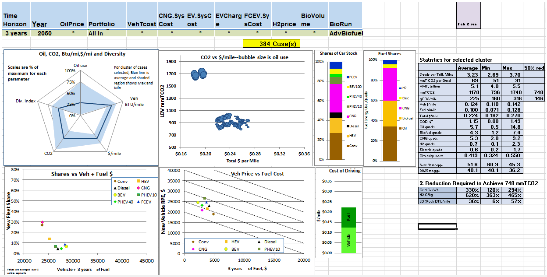
❸ Case Cluster Dashboard for Query of Output Characteristics Example: All In; 47,500 miles (3yr); 2050; Advanced Biofuels; average over all Oil Prices, Hydrogen Prices and Technology Prices

Slide 9
Backup

Slide 10
Shared Systems across Vehicle Technology Subgroups
Diesel
Conventional
CNGV
HEV
PHEV10
PHEV40
BEV100
FCEV
2008 Conventional Vehicle (based on AEO2010) – Baseline
Glider Modification Technology Options for Improved Fuel Economy
CI ICE
Internal Combustion Engine (SI ICE)
ICE Gen Set
Vehicle and Key Subsystems
ETS - partial
Electric Traction System (ETS) - full
Power Battery
Energy Battery
Power Battery
Fuel Cell Sys
CNG Storage
H2 Storage
Vehicle Design Point: minimize Vehicle Price + Fuel Cost subject to Vehicle Choice Model parameters
VCM
Hydrogen
Elec Infra A
Elec Infra B
Elec Infra C
Electricity
Fuel + Infrastructure
CNG
CI Biofuel
SI Biofuel
SI Biofuel
Diesel
Gasoline
Gasoline
Diesel
Conventional
CNGV
HEV
PHEV10
PHEV40
BEV100
FCEV

Slide 11
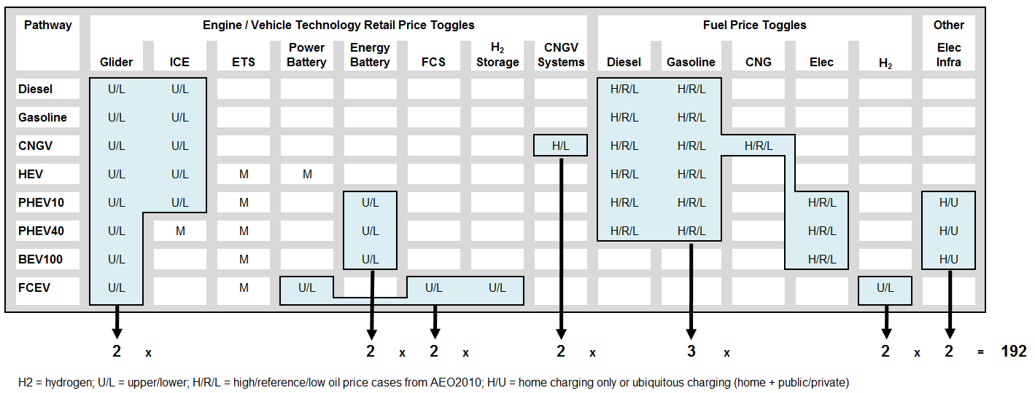
Toggle Detail and Case Combinations
Each case run with both 3-year and 17-year time horizons for a total of 192 x 2 = 384 cases

